Slide 1
Design and Analysis of Algorithm Divide and Conquer strategy (Quick Sort)
Lecture -14

Slide 2
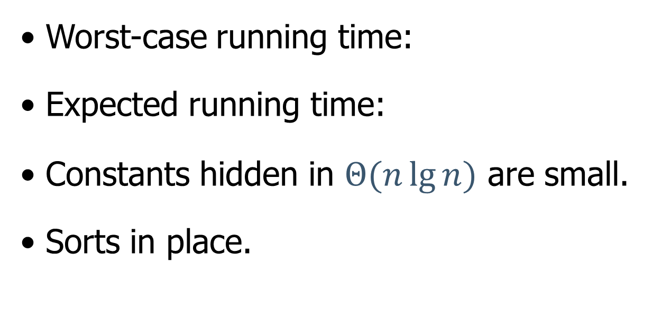


Overview
• Worst-case running time:
• Expected running time:
• Constants hidden in $Θ(n\lg{n)}$ are small.
• Sorts in place.
$$Θ(n^{2})$$
$$Θ(n\lg{n)}$$

Slide 3
Description of quicksort

Slide 5
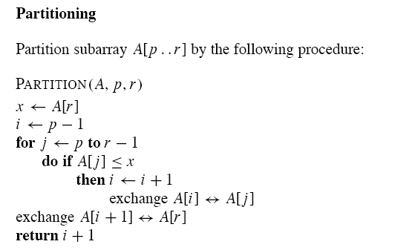

Slide 6
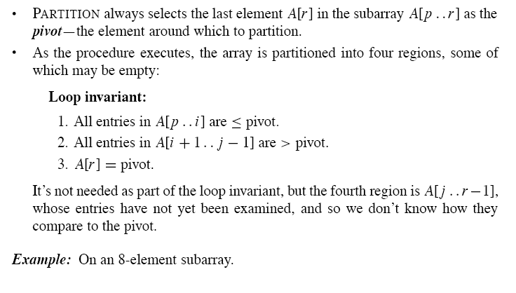

Slide 7
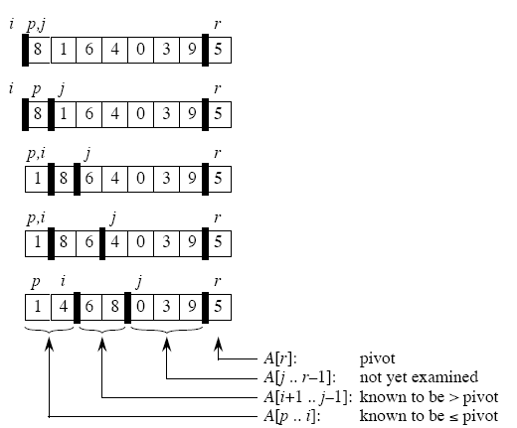

Slide 10
Performance of quicksort
The running time of quicksort depends on the partitioning of the subarrays:
• If the subarrays are balanced, then quicksort can run as fast as mergesort.
• If they are unbalanced, then quicksort can run as slowly as insertion sort.

Slide 12
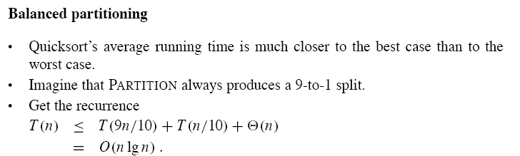

Slide 13
Randomized version of quicksort
• We have assumed that all input permutations are equally likely.
• This is not always true.
• To correct this, we add randomization to quicksort.
• We could randomly permute the input array.
• Instead, we use random sampling, or picking one element at random.
• Don’t always use A[r ] as the pivot. Instead, randomly pick an element from the subarray that is being sorted.
We add this randomization by not always using A[r ] as the pivot, but instead randomly picking an element from the subarray that is being sorted

Slide 15
Analysis of quicksort
We will analyze
• the worst-case running time of QUICKSORT and RANDOMIZED-QUICKSORT (the same), and
• the expected (average-case) running time of RANDOMIZED-QUICKSORT is O(n lg n) .

Slide 16

Thank U

